Slide 1


Image Processing &
Computer Vision
Face Recognition using Opencv
Mohammed Bilal Shakil Ahmed Khan
N01637402

Slide 2


Introduction
In this project, we delve into the realm of face recognition using OpenCV, a versatile open-source computer vision library.
The increasing need for robust security systems and seamless user experiences has driven the innovation and implementation of face recognition technologies.
Our exploration aims to harness the potential of OpenCV to build an efficient and accurate face recognition system.
Dataset: The dataset contains images of mulitple celebrities which is scraped from pinterest. There are 105 celebrities and 17534 faces.

Slide 3
Methodology
Data Collection: Data is collected from pinterest. There are 105 celebrities and 17534 faces.
Preprocessing: The images are converted to 80x80 image size and then to grayscale.
Feature Extraction: CascadeClassifier is used to recognize faces. It is a tool that you can use to detect faces in images or video frames. ‘haar_faces.xml'represents the XML file that contains the pre-trained Haar Cascade classifier for detecting faces.
Usage of Haar Cascade Classifier (haar_cascade): The detectMultiScale method is applied to identify faces in the grayscale image (gray). Detected faces are then used to extract the region of interest (ROI) from the original image.
LBPH face recognizer: LBPH is a popular algorithm for face recognition that works by extracting local binary patterns from facial images and constructing histograms of these patterns. The LBPH algorithm is known for its simplicity and effectiveness in handling variations in lighting and facial expressions.

Slide 4


Code Snippet
Feature Extraction
Add your title
Add your words here,according to your need to draw the te box size
LBPH

Slide 5



Who are they?

Slide 6
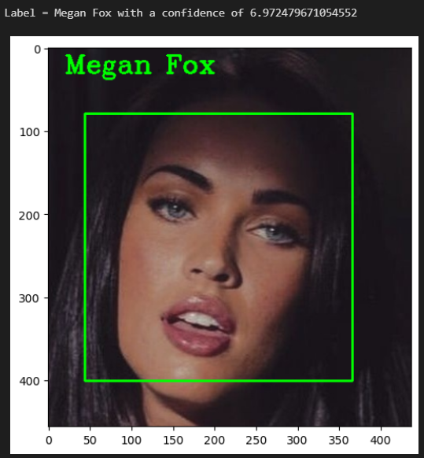
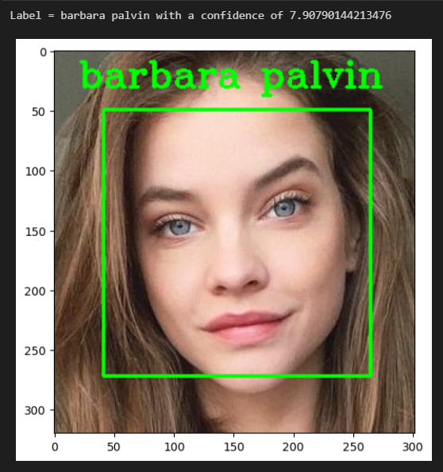
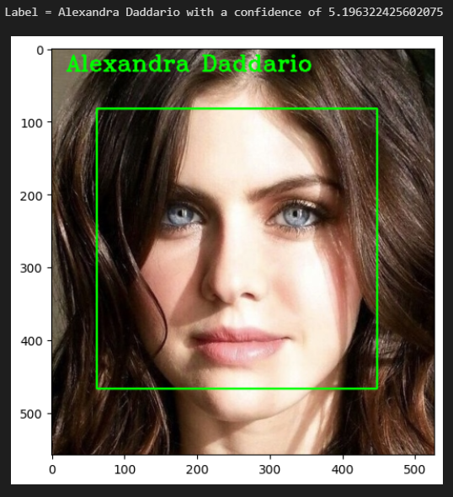
Results
Correct !!!

Slide 7
Conclusion
In conclusion, this project explored the implementation of a face recognition system using OpenCV, leveraging the Haar Cascade classifier for face detection and training an LBPHFaceRecognizer (Local Binary Pattern Histogram) for identification. The integration of computer vision techniques showcased the potential for secure and efficient biometric authentication. The project's success in training the LBPHFaceRecognizer demonstrates its adaptability to diverse faces and lays the foundation for further advancements in face recognition technology.

Slide 8
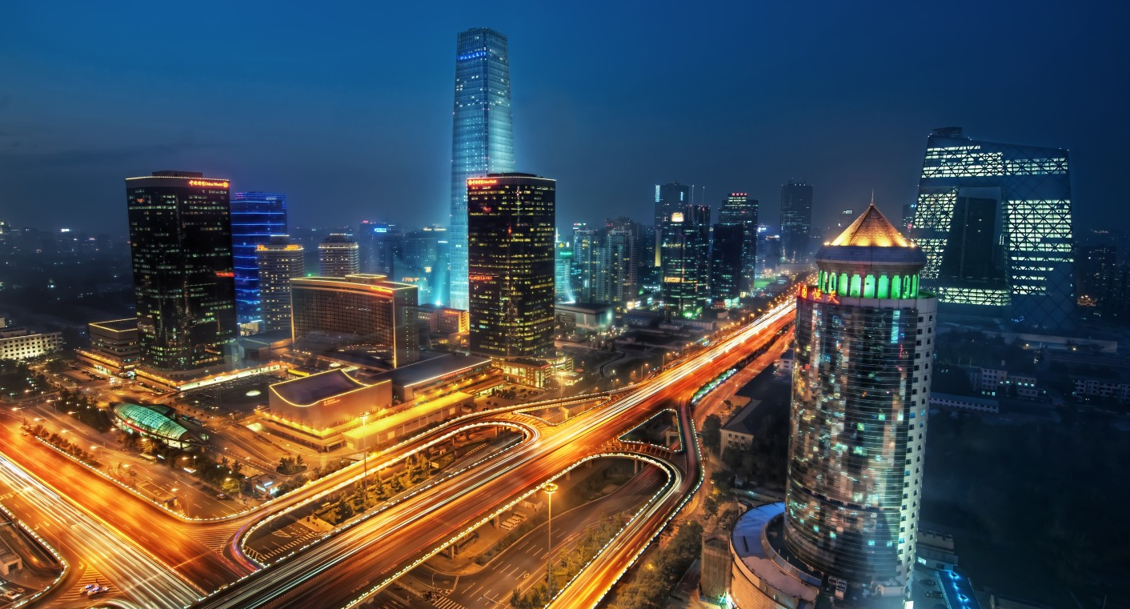
Thank You

